Slide 1
VHC
Sprint Demo : 2024 - 04 - 16

Slide 2




Table of Contents
1- SPRINT GOAL
2- STATUS
3- DEMO
4- FEEDBACK

Slide 3
FAQ: - When do we select new goals? In the review - When do we create new user stories in the planning - When do we create new tasks? In the backlog meeting

Slide 4
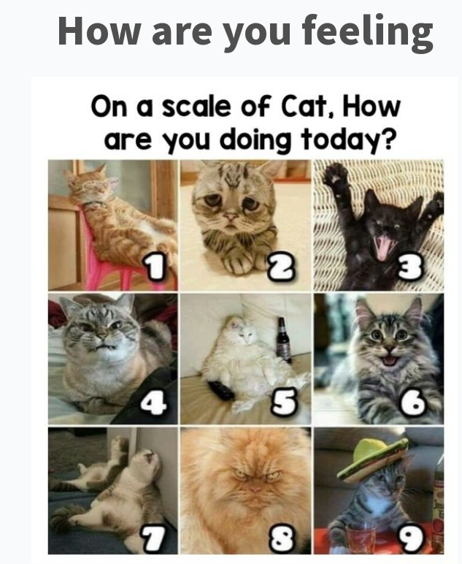

Slide 5
What were the goals this sprint

Slide 6




Programming: Webserver showing “mind graph connected to LLM”
Programming:
Webserver showing “Mind Graph”
Partnerships: Try to see who would want to help us make this
SCRUM: have live sprint demo ready Review Templates Ready UserStories And Tasks Ready

Slide 7
Programming: Webserver showing “mind graph
Programming:
See Data Sources: PreFilder
Partnerships
Formally Recruit and Onboard Ayoub
Try to recruit more for the iniatiative
Work Adventure intergrated: Website Version One.

Slide 8
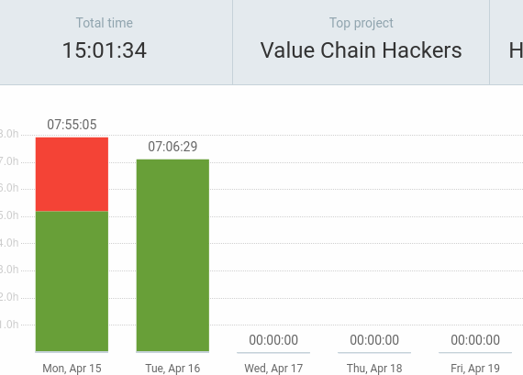
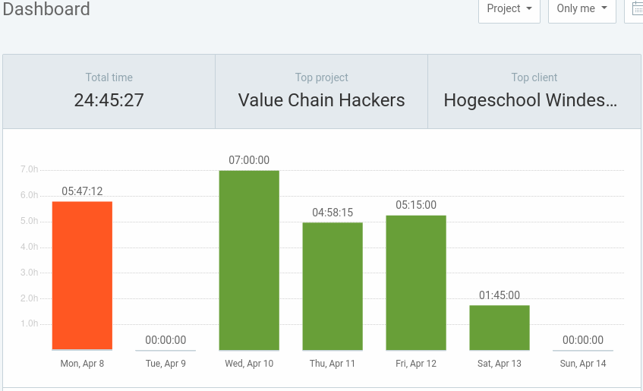
Cumulative Flow Diagram

Slide 9



🏗️DEV
🎨DESIGN
🏉ADMIN/SCRUM
🤝BD
TASK
Direct value
Enablers
🏗️Taiga Board Now Operational: Scrum Framework working: And publicly available
🏗️ Thinking about Data Formats
🏗️ Learning About LLM
🏗️ Learning DS.3J
️ Ponomoro method
🏗️ Dev-Ops
🏗️ Starting Clockify
🏗️ Organisation of Tasks – increases accountability + Reduces chances of Restart
✔️saves $$/month
🏗️Staging demo prepared
✔️stakeholders see app working
🏗️Development environment done ✔️Speeds up future work
✔️Can do things normal evironments cannot
✔️Preparation for future members
🎨 Created Scripts to Automatically install nessesairy Software
✔️Will help us onboard faster
🎨 Clockify helps us track time spend vs ✔️Keep Track of Effort Done
🎨 Docker – App – Portainer for Language and models
🎨 Visual workplace – Fun For Collab

Slide 10

Demo

Slide 11
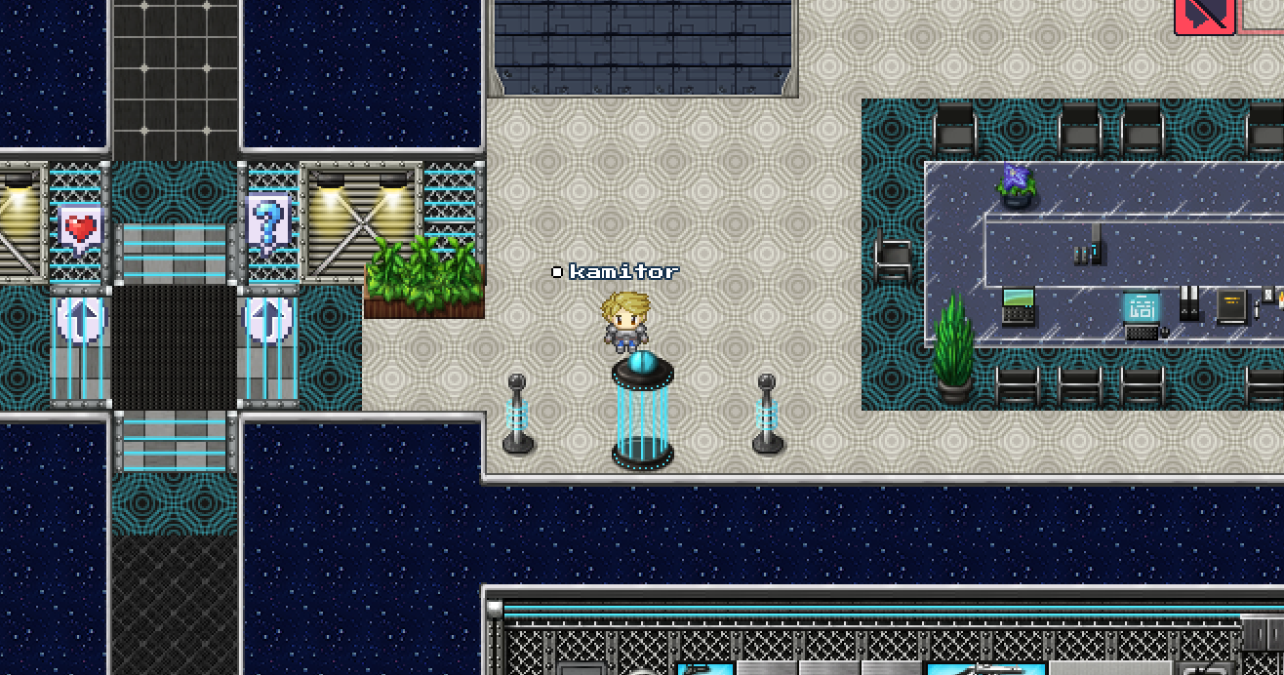
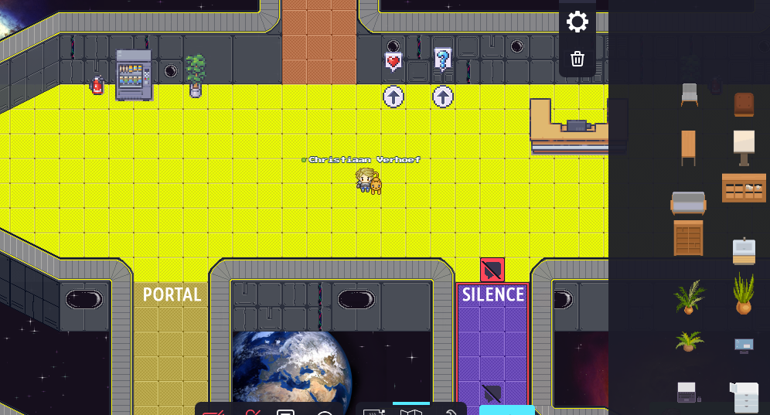
🎨 Social Media & outreach
https://supply-chain-970bd9.webflow.io/
WORK ADVENTURE!!!!

Slide 12
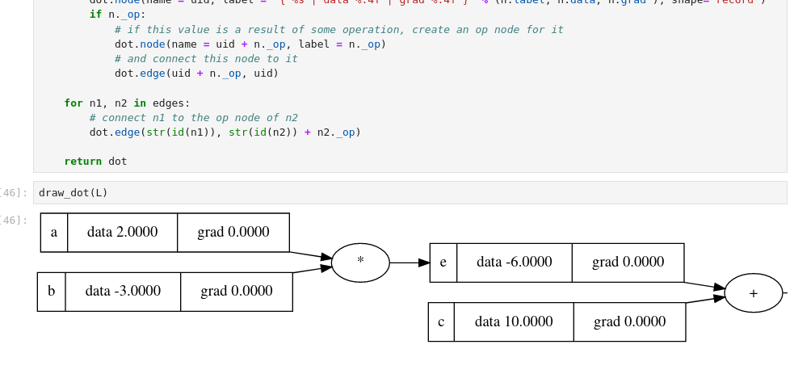
🎨 Other Platforms

Slide 13
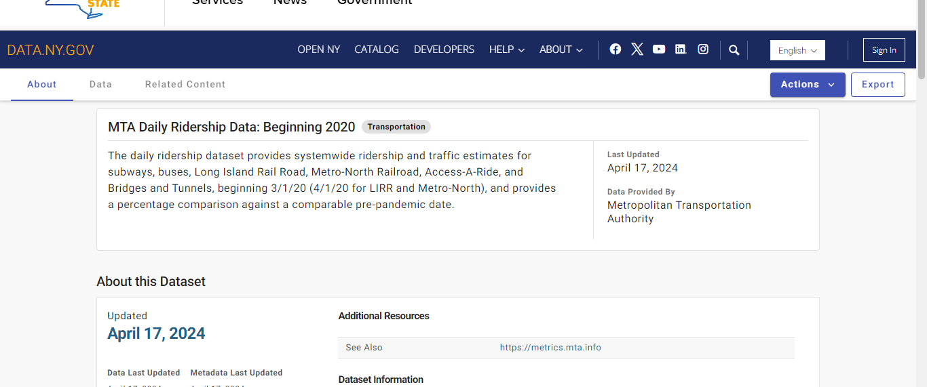
🎨DATA

Slide 14
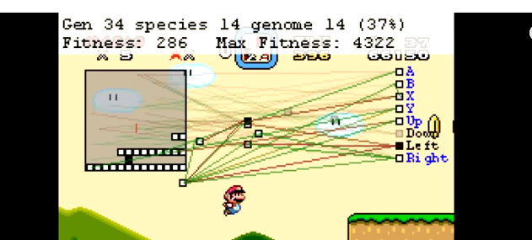
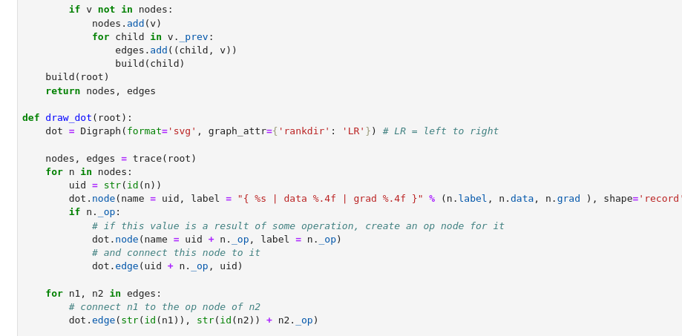
🎨Knowledge
https://www.youtube.com/watch?v=qv6UVOQ0F44
Now know inner Workings Of Ai

Slide 15
🏗️PROBLEMS
NO GOOD CI / CD EVIRONMENT YET BUILD – FAILURE OF COTIT

Slide 16
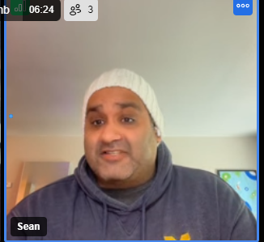
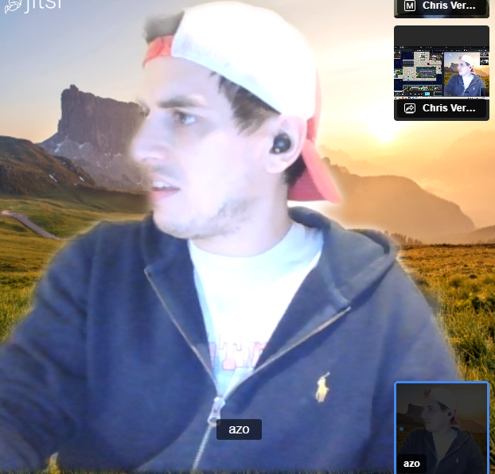
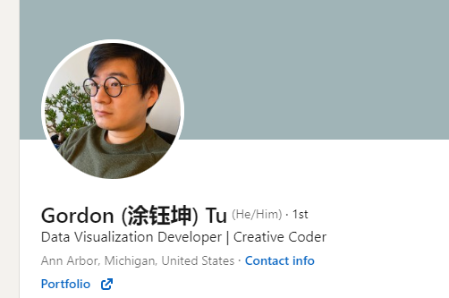
🤝Partnerships
Arkin Zoodsma
Nikita
Ayoub
https://www.linkedin.com/in/gordon-tu/

Slide 17
Priority Finding:

Slide 18
FEEDBACK: PollEv.com​/chrisverhoef134

